Slide 1
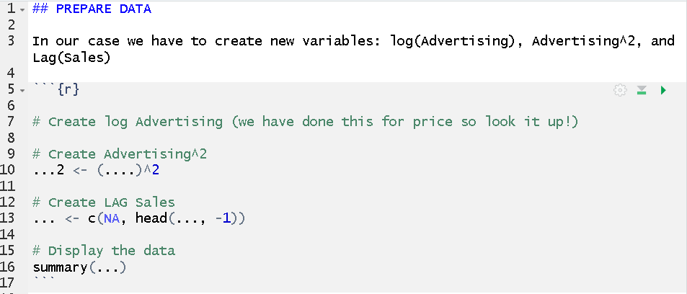
We often have to create some new variables from our data. In my example here the data is called “data.advertising”
Make a new data vector
The “c” function helps you to make a lagged vector (i.e., “move back in time”). You only need to give the command the name of the vector you want to lag. “-1” mean you want to go one unit back in time. In our case we have days. If you would want to go back 2 days, you would use “-2”.

